Slide 1
Csci465: Principals of Translations
Chapter 4: Syntax Analysis
UND School of Engineering and Mines
Department of Computer Science
Dr. Hassan Reza

Slide 2
Announcement
Exam 1:
Oct.19th

Slide 3
Objectives
Parser and its role in the design of compiler
Techniques used to build hand implementation parses
Top-down parsing
LL parser
Algorithms used to build automated parser generators
Bottom-up parsing
LR parser
Simple LR (SLR)
CFG
Derivations
leftmost
rightmost
FISRT and FOLLOW
Error Recovery Handling Techniques

Slide 4
Syntax Analysis
Every Programming Language (PL) has a set of rules prescribing the syntactic structure of the programs written in that language
E.g., Pascal Programming Language
Made out of Blocks
A block made out of statements
A statement is made out of expressions
An expression is made out of tokens
A token is made out of characters specified by RE

Slide 5
Grammar
Wikipedia definition
In linguistics, grammar is the set of structural rules governing
the composition of clauses
phrases
words in any given natural language.
The term also refers to the study of such rules,
Including morphology (shape), syntax, and phonology (sound),
Can be complemented by phonetics, semantics, and pragmatics.

Slide 6
Formal Grammars
Formal Grammars?
A set of production rules for composing strings (words) in a formal language.
Rules describe how to put the words together in a sense that the sentence meets the proper syntactical form

Slide 7
Significant of Grammars
Significant of Grammars
Provides a precise, easy-to-understand syntactic specifications
Automates the construction of an efficient parser
Supports maintainability of an existing language implementation by adding new programming constructs

Slide 8
Parser vs. Scanner
Lexical analyzer?
Recognizes token (i.e., terminal symbols) from the sequence of characters in an input string
Parser?
Recognizes a set of related words (or phrases)
How theses words are combined to form syntactically correct program

Slide 9
Limitation of Regular Expression (revisited)
Regular expressions and its recognizers are suitable for identifying error at word level
E.g.,
misspelling an identifier, keyword, or operator
RE cannot be used to handle nested or balanced parentheses
E.g., An arithmetic expression with unbalanced parentheses

Slide 10
Role of parser
Source
Pg
Token/getchar()
LA
Parser
Parse tree
code
Rest of FE
Sym. Table

Slide 11
Types of Parser
Universal Parsing methods
Cocke-Younger_Kasami Algorithm
Parse any grammar
Not very efficient to use production compilers
Top-down
LL parsers (hand-written)
Bottom-up
LR parsers (automated)

Slide 12
Context Free Grammar (CFG)
Grammar can be used to describe most of syntax of PL
PLs allow sentence construction with nested and matched parentheses
Some PL construct cannot be defined by Grammar
E.g., Define/use
These languages are specified by CFG
Every language defined by CFG can be recognized by Push Down Automata (PDA) or any Language accepted by PDA is CFG

Slide 13
CFG and PDA
The focus here is on Context Free Language (CFL) that are accepted by PDAs
CFL:
languages defined by LL(K) Context-Free Grammars
LL?
parses the input from Left to Right, and constructs a Leftmost derivation of the sentence

Slide 14
Left Most Derivative

Slide 15
Notations

Slide 16
LL Parsing
What is LL(K) grammar?
A grammar from which we can construct a deterministic, top-down PDA that looks a head at most k symbols in the input tape
What is LL(1) grammar?
The most common form of LL(K) grammar
Looks a head at most one symbol
The easiest one to convert into PDA

Slide 17
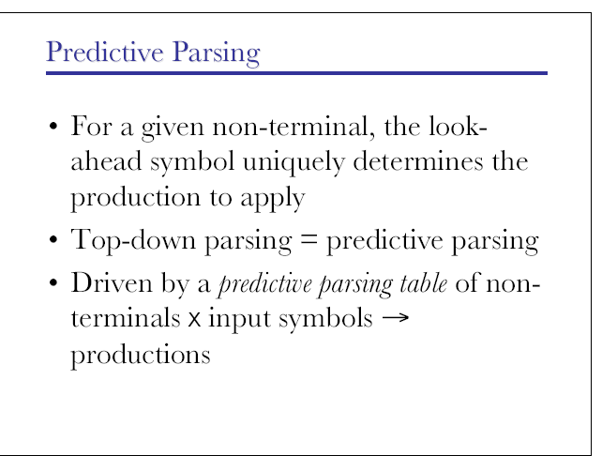
Predicative Parsing

Slide 18
Example

Slide 19
push-down automaton (PDA): 1
A push-down automaton is formally defined as a 7-tuple as follows
P = (∑, Q, ▲, H, h₀, q₀, F)
∑: Alphabet
Q: states
▲: transition functions
H: finite stack alphabet
h_{0:} initial symbol in H (stack)
q_{0:} Initial state
F: finite set of final state

Slide 20
push-down automaton (PDA): 2
▲ has the following functionality
T:Q×(∑∪∈)×H→Q×H*
i.e., every transition is defined for a particular state;
reads one input token or skip the input
pops one symbol off the stack
moves to a new state
pushes a string of zero or more symbols back onto the stack

Slide 21
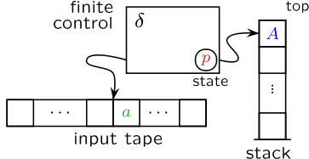
Model of PDA

Slide 22
Example 1: PDA
Let P₀ = PDA
∑={a, b, c},
Q={A,B,C},
▲ {T:Q×(∑∪∈)×H→Q×H*},
H={h,i},
h₀= i,
q₀=A,
F={ }
Where ▲ can be defined as follow
T(A, a, i) = (B, h)
T(B, a, h) = (B, hh)
T(C, b, h) = (C,∈)
T(A, c, i) = (A, ∈)
T(B, c, h) = (C, h)

Slide 23
Table: PDA on input aacbb
Configurations | Transitions | Actions
(A, aacbb, i) | T(A, a, i) = (B, h) | read a, pop i, push h, go to B
(B, acbb, h) | T(B, a, h) = (B, hh) | read a, pop h, push hh, go to B
(B, cbb, hh) | T(B, c, h) = (C, h) | read c, pop h, push h, go to C
(C, bb, hh) | T(C, b, h) = (C,∈) | read b, pop h, go to C
(C, b, h) | T(C, b, h) = (C,∈) | read b, pop h, go to C
(C,∈, ∈) | STOP! | String is successfully parsed

Slide 24
Push Down Automata (PDA): Implementation
PDA used to implement top-down parser
Starts with the goal symbol on the stack
Rewrites the leftmost non-terminal until the leftmost symbol is a terminal , which is the first token of the input string
Takes the transition that reads that token
Repeats the process until
the entire input has been read and no more input left
Or PDA blocks

Slide 25
Top-Down Parsing (revisited)
Top down parsing
Building a parse tree for input string
Starting from the root
Creating the nodes for the tree in preorder (depth first) fashion
Finding a leftmost derivation for an input

Slide 26
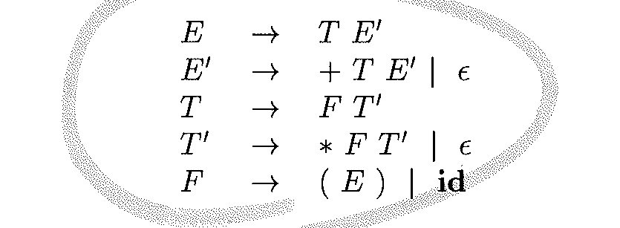
Example: Grammar for Arithmetic expression

Slide 28
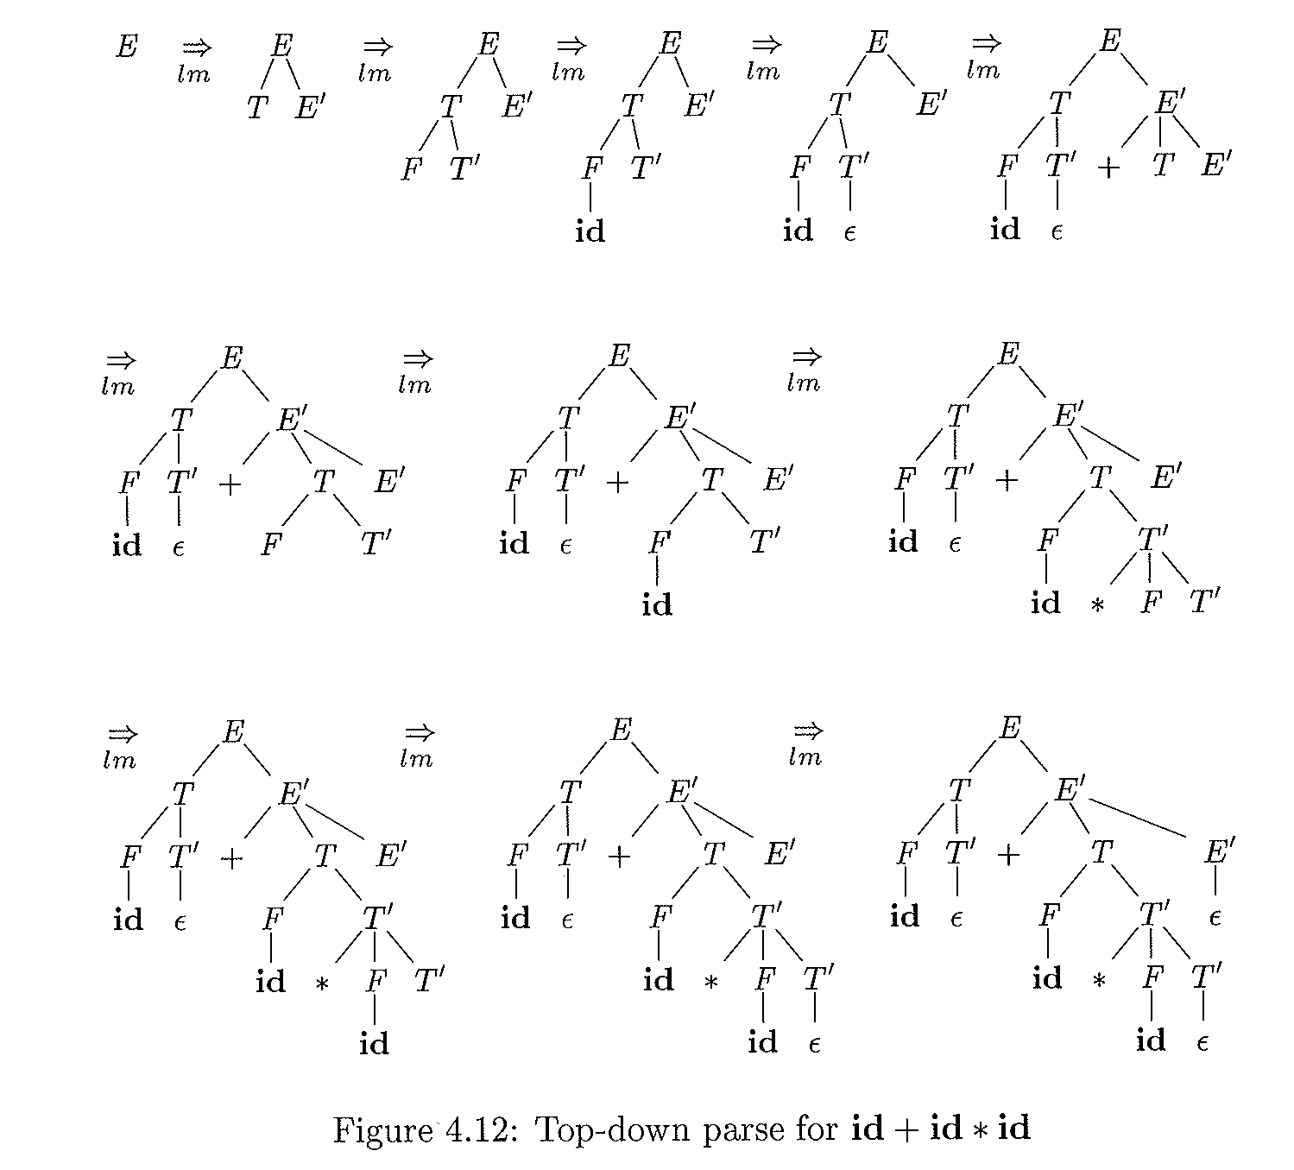

Slide 32
Quiz( 10-5-2017)

Slide 33
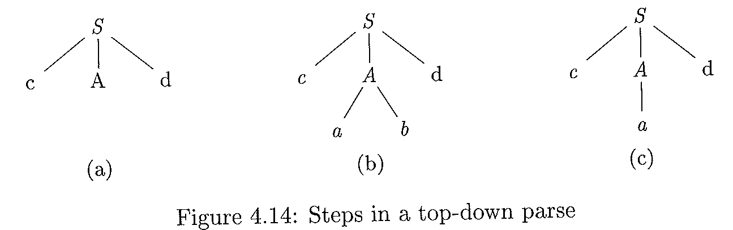
Suppose G defined as follows:
S → c A d
A→ a b| a
Input: cad

Slide 34
FIRST and FOLLOW
The construction of both top-down and bottom-up parsers require two functions
FIRST()
FOLLOW()
These two functions help to select the appropriate production rule

Slide 35
FIRST and Follow Sets
To show a grammar is LL(K), perform the following steps
Buid First_{k}(w) for all right hand sides string w in the grammar’s production
Build Follow_{k}(N) for all non-terminals N in the grammar
Create Selection sets for all productions
First and Follow sets help to fill in the entries of the parsing table

Slide 36
FIRST_{k}(w)
The FIRST_{K} of any string w is the set of all terminal strings of K-tokens or fewer that can be derived from string w
First_{k}(uv) = First_{K}(First_{K}(u)First_{K}(v))
(i.e., first of u concatenated with first of v)
First_{k}(N) = ∪(First_{K}(w))
(i.e., the union of all first of N such that N→w is a production)
First_{k}(x) = {x}
(i.e., for any terminal x∈∑, then first is x itself)
First_{k}(∈) = {∈}
(i.e., for empty string)

Slide 37
Example 1: Compute the first
First₂(uv) = First₂(First₂(u)First₂(v))
Where
First₂(u)={ab, cd, d, dd, ∈}
First₂(v)={cc, d, ∈}
therefore
First₂(uv) is formed by concatenating each of the First(u) with First (v )
{abcc, abd, ab, cdcc, cdd, cd, dcc, dd, d, ddcc, ddd, dd, cc, d, ∈}
Take the first two chars
{ab, ab, ab, cd, cd, cd, dc, dd, d, dd, dd, dd, cc, d, ∈}
Removed the duplicates
First₂(uv)={ab,cd,dc,dd,d,cc, ∈}

Slide 38
Example 2
Consider the simple grammar G:
A→Ba
B→b
B→c
Get the First₁(A) = First₁(First₁(B)First₁(a))
=First((First(b)∪First(c))×First(a))
=First₁( {b, c}×{a} )
=First₁( {ba, ca} )
={b,c}
where
First(b)={b}
First(c)={c}
First(a)={a}

Slide 39
Follow_{k}(A)
Follow Set of a nonterminal A?
Refers to the set of terminals that can follow a nonterminal A in some sentential form
Follow(A) = {bϵ∑| S ==>⁺αAbβ}
Provides the proper context for nonterminal A

Slide 40
To Compute Follow set
For all production B→uAv, the Follow_{k}(A) can be built
Follow_{k}(A) = ∪(First_{k}(First_{k}(v)Follow_{k}(B))
To compute the Follow(A):
look in the grammar for all productions in which A occurs in the R.H.S
apply the following rules:
the FIRST of everything to the right of the A, including the Follow(B), where B is the non-terminal on L.H.S // B→uAv
If A is the start symbol , then put $ in Follow (A)
If v is nonterminal, then everything in FIRST(v) except for ∈ is in Follow(A)
If v derives ∈ (i.e., v⇒* ∈), then Follow(A) = Follow(B)

Slide 41
Example 2: Compute Follow
Consider the following grammar
S→Bx
A→aA
A→b
B→yAzA
Compute the Follow₁(A)?

Slide 42
Follow: Example 1 (solution)
Consider the following grammar
S→Bx
A→aA
A→b
B→yAzA
Compute the Follow₁(A)?
Find All A on the R.H.S (there are 3 As)
Find any terminal right after A
Add the terminal, z, to the set = {z}
Find Follow of non-terminal on L.H.S of A (i.e., B)
Follow(B)=First(x)= {x}
Follow(A) is L.H.S ignored (i.e., Rule.2)? recursion
Follow (A)= {z} U{x} = {z,x}

Slide 43
Example 2: First and Follow
Consider the following grammar
E→TE’
E’→+TE’ |∈
T→FT’
T’→*FT’| ∈
F→(E)| id

Slide 44
Example 2: First and Follow
Consider the following grammar
E→TE’
E’→+TE’ |∈
T→FT’
T’→*FT’| ∈
F→(E)| id
FIRST (E)=FIRST(T)=FIRST(F)={(,id}
FIRST(E’)={+, ∈}
FIRST(T’) = {*, ∈}

Slide 45
To compute Follow for the Grammar
Consider the following grammar
E→TE’
E’→+TE’ |∈
T→FT’
T’→*FT’| ∈
F→(E)| id
FOLLOW(E)= {), ∈} //applied rules 1, 2//
FOLLOW(E’)={), ∈} //applied rules 1, 2//
FOLLOW(T)= First(E’) U Follow(E)= {+, ), ∈}
FOLLOW(T’)= FOLLOW(T)= {+, ), ∈} // applied rules 3, 4//
FOLLOW(F) = Follow (T’) U First (T’)= {*, +, ), ∈}
// applied rules 3, 4//
Notes:
Apply the following rules to compute Follow set.
the FIRST of everything to the right of the A, including the Follow(B), where B is the non-terminal on L.H.S // B→uAv
If A is the start symbol, then put $ in Follow (A)
If v is nonterminal, then everything in FIRST(v) except for ∈ is in Follow(A)
If v derives ∈ (i.e., v⇒* ∈), then Follow(A) = Follow(B)

Slide 47
Selection Sets
The selection set of Select_{k} of a production is the set of lookahead strings of K-tokens t
The set helps the selection of that production in a deterministic top-down parser

Slide 48
How to compute Selection Set?
For each production in a grammar of the form A→w
Select_{k}(A→w)=First_{k} (First_{k}(w) Follow_{k}(A))
A nonterminal A in a grammar is LL(K) iff
For any two selection sets S₁ and S₂ of the productions A the following condition holds
S₁∩S₂ = {}
A grammar is LL(K) if EVERY non-terminal in that grammar is LL(K) (i.e., S₁∩S₂ = {})

Slide 49
Example of Selection
Consider the simple grammar G
S→aSb
S→∈

Slide 50
Example of Selection
Consider the simple grammar G
S→aSb
S→∈
1. S→aSb
Select₁(S→aSb ) = First₁ (First₁(aSb) Follow₁(S))
First₁({a} × {$,b})
Note: S is a goal symbol
First₁ ({a$, ab})
{a}

Slide 51
Example of Selection
Consider the simple grammar G
S→aSb
S→∈
2. S→∈
Select₁(S→∈) =
First₁(First₁(∈)Follow₁(S))
First₁({∈} Follow₁(S))
First₁ ({∈} X{$,b})
{$,b}

Slide 52
Example of Selection
Consider the simple grammar G
S→aSb
S→∈
2. S→∈
Select₁(S→∈) =
First₁(First₁(∈)Follow₁(S))
First₁({∈} Follow₁(S))
First₁ ({∈} X{$,b})
{$,b}
{$,b} ∩{a} = {}
//i.e., means they have no elements in common for two selections
Therefore, the G is LL(1)

Slide 53
Example
Consider the following grammar
S→Bx
A→aA
A→b
B→yAzA
B→AA
Compute Follow₁(A)?

Slide 54
Converting RE to FA to CFG

Slide 55
Converting CFG to PDA:1
PDA can be constructed from a CFG as follows:
PDA.∑ == CFG. ∑
PDA.H == ∑∪N //finite stack alphabet
PDA.h₀ == Goal of CFG
PDA.Q == One state; it halts on empty stack

Slide 56
Converting CFG to PDA: 2
Two rules
1. T(q, x, x) = (q, ∈) (i.e., for every terminal x)
2. T(q, ∈, A) = (q, ω) (i.e., replace A on LHS by RHS ω)
Notes:
Where
ω = a set of terminal and non-terminal symbols on R.H.S

Slide 57
Example: From CFG to PDA
Consider the following Grammar G1 that generates all equal numbers of a’s followed by an equal number of b’s
L(G) ={aabb, aaabbb, …}
S→aSb |∈
First (S) = {a, ∈}
Follow (S) = {b}

Slide 58
Example 2: Transitions
Covert G1 to PDA
T(q,∈, S) = (q, aSb) < apply rule 2 for nonterminal>
T(q,∈, S) = (q, ∈) <apply rule 2 for nonterminal>
T(q, a, a) = (q, ∈) < apply rule 1 for terminal>
T(q, b, b) = (q, ∈) < apply rule 1 for terminal>

Slide 59
Example2: Parsing
Apply 1 using First (S) = {a, ∈}
Step | Input | Stack | Transition
1 | .aabb | S
2 | .aabb | aSb | 1
3 | a.abb | Sb | 3
4 | a.abb | aSbb | 1
5 | aa.bb | Sbb | 3
Input string: aabb
Cnfg₀: (q, aabb,S)
Transitions:
T(q,∈, S) = (q, aSb)
T(q,∈, S) = (q, ∈)
T(q,a, a) = (q, ∈)
T(q,b, b) = (q, ∈)
Notes:
The grammar is LL(1) because a deterministic top-down PDA can be constructed using one lookahead symbol

Slide 60
Example2: Parsing
Apply 1 using First (S) = {a, ∈} won’t work!
Step | Input | Stack | Transition
1 | .aabb | S
2 | .aabb | aSb | 1
3 | a.abb | Sb | 3
4 | a.abb | aSbb | 1
5 | aa.bb | Sbb | 3
6 | aa.bb | aSbbb | 1 (No match!!!)
Input string: aabb
Cnfg₀: (q, aabb,S)
Transitions:
T(q,∈, S) = (q, aSb)
T(q,∈, S) = (q, ∈)
T(q,a, a) = (q, ∈)
T(q,b, b) = (q, ∈)
Notes:
The grammar is LL(1) because a deterministic top-down PDA can be constructed using one lookahead symbol

Slide 61
Example2: Parsing
Step | Input | Stack | Transition
1 | .aabb | S | No move
2 | .aabb | aSb | 1
3 | a.abb | Sb | 3
4 | a.abb | aSbb | 1
5 | aa.bb | Sbb | 3
6 | aa.bb | bb | 2
7 | aab.b | b | 4
8 | empty | empty | 4
Input string: aabb
Cnfg₀: (q, aabb,S)
Transitions:
T(q,∈, S) = (q, aSb)
T(q,∈, S) = (q, ∈)
T(q,a, a) = (q, ∈)
T(q,b, b) = (q, ∈)
Apply 2 using Follow (S) = {b}
Notes:
The grammar is LL(1) because a deterministic top-down PDA can be constructed using one lookahead symbol

Slide 62
Note on example
The grammar is LL(1) because non-determinism is resolved only by looking at one symbol
Applied 1 (i.e., S→ aSb)
the string is ‘abb’ and ‘a’ is the first token in S on R.H.S
Applied 2 (i.e., S→∈ )
the current input string is a ‘b’, which matches the token that follows S in the S→aSb

Slide 63
Construction of Predictive Parsing Table using First and Follow sets
The following algorithm collects and uses the information from FIRST() and FOLLOW() sets into a predictive parsing TABLE M[A,a]
where
M = 2 Dimensional Array (table)
A = a non-terminal
a ∈{Σ∪$} (i.e., current terminal)

Slide 64
Parsing Table Algorithm
Algorithms
Grammar
Parsing Table

Slide 65
Algorithm 4.31 (pp 224)
INPUT: G (Grammar)
OUTPUT: Parsing table M
METHOD:
For each production A→α of G, do the following:
For each terminal a in FIRT (A), add A→α to M[A, a]
If FIRST(α) = ε , then for each terminal b ∈ FOLLOW(A), add A→α to M[A,b]
If FIRST(α) = ε and $ is in FOLLOW(A), add A→α to M[A,$]
Otherwise set M[A,a] to error

Slide 66
Example : Table Driven
Consider the following grammar
E→TE’
E’→+TE’ |∈
T→FT’
T’→*FT’
F→(E)| id

Slide 67
Productions
Notes:
FIRST(E)= { (, id}

Slide 68
Productions
Notes:
FIRST(E)= { (, id}

Slide 69
Productions
Notes:
FIRST(E)= { (, id}

Slide 70
Productions
Notes:
FIRST(E)= { (, id}

Slide 71
Productions
Notes:
FIRST(E)= { (, id}

Slide 72
Implication of Algorithm 4.31
The algorithm can be applied to any grammar G to produce a parsing table
For any LL(1) grammar, each parsing table entry uniquely identifies a production or signals an error
Note:
For Grammar G that is not LL(1), we may have multiple entries!!!

Slide 73
Non-recursive Predictive Parsing: Table-driven
Table-driven approach parser
Input buffer
contains the string to be parsed
A stack (used stack instead of recursive calls)
Grammar symbols with $ at the bottom
A parsing table
Two-dimensional array M[A, a] indexed by non-terminal A and terminal a
Output
Desired code (or call to error recovery routine)

Slide 74
The semantics of parser
The behavior of the parser can be specified in terms of its configurations
Initial configuration consists of w$ in the input buffer
Where
w is the string of input symbol
$ (end of input marker)
S: Start symbol on top of the stack

Slide 75
Model of a table-driven predictive parser
Input
stack
PP-Program
output
Parsing Table M

Slide 76
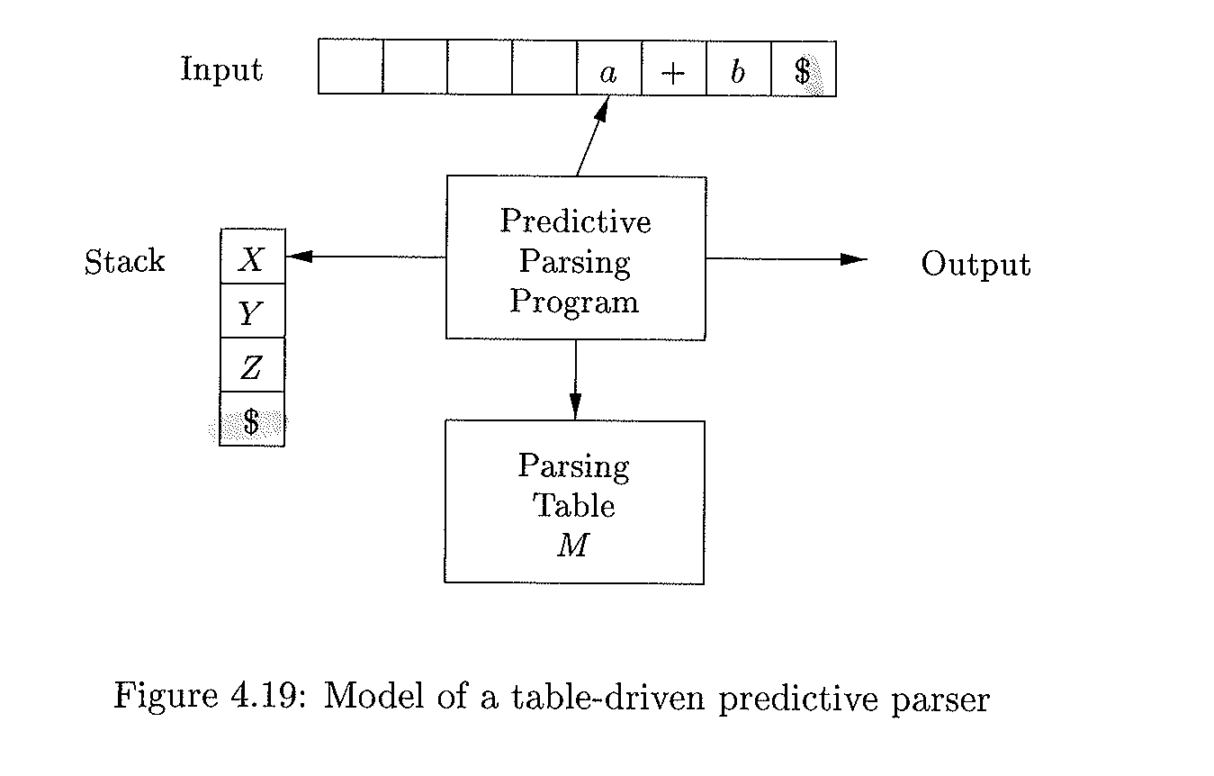
Model of a table-driven predictive parser using Stack (no recursion)
End of input marker
End of input marker

Slide 77
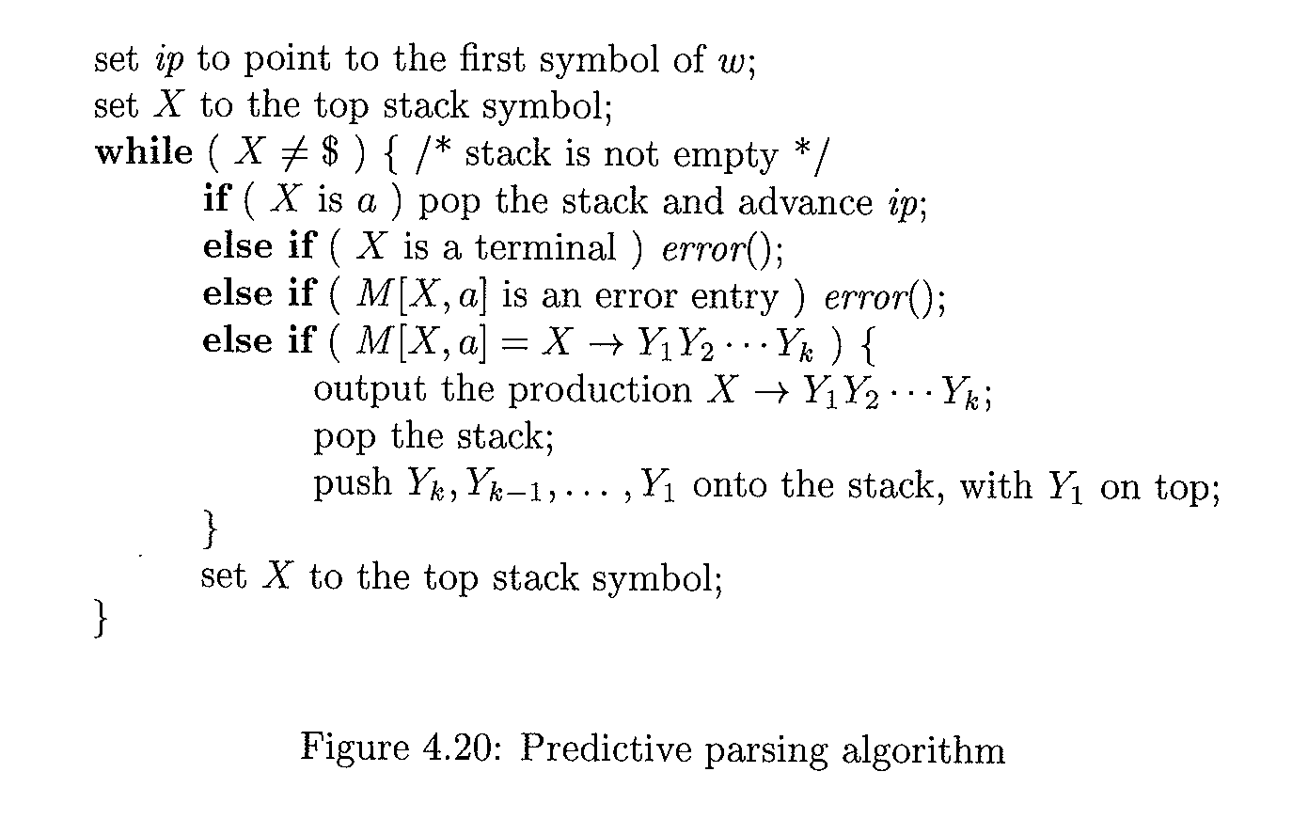
Program using parsing table (pg22 in ASU)
Algorithm :Non-Recursive Predictive Parser
Input: A string w and a Parsing table M for Grammar G
Output: if w is in L(G) a leftmost derivation of w; otherwise, an error indication
Method

Slide 78
Example : Table driven
Consider the following grammar
E→TE’
E’→+TE’ |∈
T→FT’
T’→*FT’
F→(E)| id

Slide 79
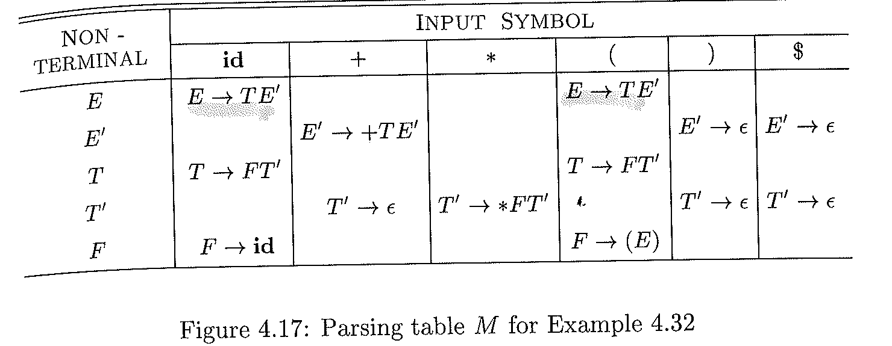
Parsing Table for the grammar 4.11

Slide 80
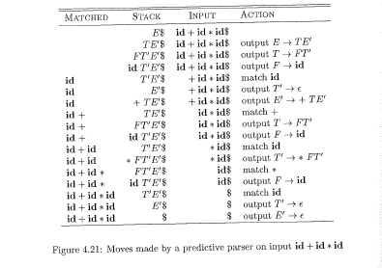
Figure 4.21

Slide 81
Syntax Errors
Program can contain errors at many different
Lexical
E.g., misspelling
Syntactic
E.g., arithmetic expression with unbalanced parentheses
Semantics
E.g., incompatible types
Logical
E.g., infinite loop

Slide 82
Parsing Error handler
The error handler in the parser should achieve proper reporting
The presence and the nature of errors explicitly
Recover from each error quickly

Slide 83
Issues
How should error handler report the presence of error?
Print the offending line
How should the parser recover?
quit
Quitting? Not an option because more errors in input is still possible

Slide 84
Error-Recovery Strategies
Panic mode
discards input symbol
Phrase level
perform local correction on the rest of input
Error production
Augment G with error productions
Global correction
find y; transfer y to x with minimal changes
Expensive (time/space)!!!

Slide 85
Panic-mode error recovery
Works with synchronization token, which are tokens used in delimiters
E.g., semicolon, end, etc.
Error Recovery Panic-mode error
Skips symbols on the input until a token in is in Sync set
Where Sync
A set of words using FOLLOW function (e.g. Semicolon in C and Pascal)
Follow and First sets can be used in the sync set
Sync set then is used in Parsing table as follows:
If M[A, a] = sync, then pop non-terminal
If M[A, a] =“ ”, then skip input symbol ‘a’
If input symbol ‘a‘ does NOT match terminal on the stack, then
pop terminal on the top of stack
Issue a message (e.g., token is inserted)
resume paring

Slide 86
Solution for Follow()
Consider the following grammar
E→TE’
E’→+TE’ |∈
T→FT’
T’→*FT’| ∈
F→(E)| id
FOLLOW(E)={), $}
FOLLOW(T)= {+, ), $}
FOLLOW(F) = {*, +, ), $}
Synch-set= {*, +, ), $}

Slide 88
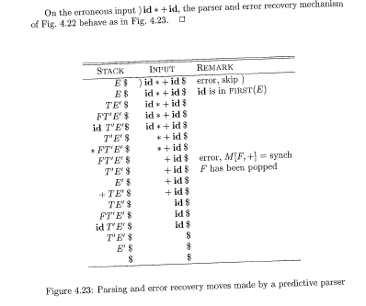

Slide 89
Left Recursion and Left Factoring
A grammar is a left recursive if it has a non-terminal A such that
A⁺⇒Aα
Left Recursion eliminations methods
Immediate left recursion
Non-immediate left recursion

Slide 90
Immediate left recursion
A→A α|β
Can be transformed to
A→βA’
A’→ αA’|ε
Elimination process
Group the offending production A
Introduce non-terminal A’
Append non-terminal A’ to the right of both type of productions (i.e., offending and non-offending)

Slide 91
Left Recursion elimination: General technique
A→A α₁| A α₂| A α₃| …|A α_{n}| β₁ | β₂ |…| β_{n}
where none of β_{I} begins with A
Can be transformed into
A→β₁ A’| β₂ A’|…| β_{n}A’
A’→ α₁ A’| α₂ A’| …| α_{m} A’| ε
where
None of α_{i} is empty
Problem:
The approach does not eliminate left recursion involving derivations (BAD)

Slide 92
Non-immediate elimination
Consider the following grammar
S→Aa |b
A→ Ac|Sd| ε
S is left-recursive? why? S⇒Aa⇒Sda
First eliminate the derivation
S→Aa |b
A→ Ac|Aad|bd| ε //replace S by its r.h.s in A
Then apply immediate left recursion elimination methods
S→Aa |b
A→ bd A’| A’
A’→ cA’|adA’| ε

Slide 93
Left Factoring
When the selection between the alternative of a production is NOT clear
Need to delay the selection until there is enough information

Slide 94
Left Factoring : Example
Suppose we have the following Grammar G
Stmt→if Exp Then Stmt
Stmt→if Exp Then Stmt else Stmt
G is NOT LL(1)
Why not?
Remove left-factored
Stmt →if Exp Then Stmt Rest
Rest→ else Stmt | ε

Slide 95
Summary of Non-Context Free Language Constructs
Programming constructs that cannot be specified using grammar
Define/USE
Counting number of formal parameters and actual parameters.

Slide 96
examples
Examples:
Define/Use: L1 = {wcw| w is in (a|b)*}
Where
the first w= declaration;
c: program;
the second w= usage
Grammar for C, Java, or Pascal does not distinguish among identifier presented by different character
Checking the number of formal and actual parameters in procedure calls:
L2 = {Formal^{n} Actual^{m}| n≥1 and m≥1}
Possible Solution:
Leave them up to semantic analyzers to handle them!!!

Slide 97
Part 2: Bottom up Parsing methods
Csci465

Slide 98
Bottom up parsing
Bottom up parsing
Refers to the construction of a parse tree using an input string staring from the leaves (bottom) all the way towards the root of the tree

Slide 99
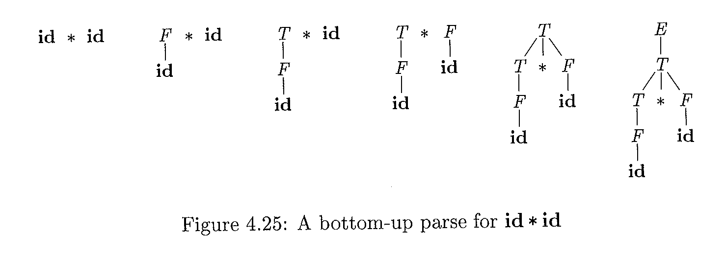
Example id*id
Grammar G:
E→ E + T | T
T→ T * F | F
F→ (E )| id

Slide 100
Example
Consider the following grammar
S→aABe
A→Abc|b
B→d
Input: abbcde
abbcde can be reduced to S (i.e., goal symbol)
abbcde ⇒aAbcde⇒aAde⇒aABe⇒S

Slide 101
Reverses Rightmost Derivation (rm)
Using Rightmost derivation starting from S
S⇒_{rm} aABe⇒_{rm} aAde ⇒_{rm} aAbcde⇒_{rm} abbcde
S→aABe
A→Abc|b
B→d

Slide 102
Handles
Handle?
The opposite of derivation
A substring on the R.H.S that can be replaced with the non-terminal on the L.H.S in the reverse process of rightmost derivation
Example
abbcde
aAbcde; b is the a handle at position 2
S⇒_{rm} aABe⇒_{rm} aAde ⇒_{rm} aAbcde⇒_{rm} abbcde

Slide 103
Example 4.23
Consider the following grammar
E→E +E
E→E * E
E→ (E)
E→id

Slide 104
Handle Pruning
Right-Sentential | Handle | Reducing Production
id₁ + id₂ * id₃ | id₁ | E→id
E+ id₂ * id₃ | id₂ | E→id
E + E * id₃ | id₃ | E→id
E + E * E | E*E | E→E*E
E + E | E+E | E→E+E
E | - | -

Slide 105
Shift-Reduce Parsing(SRP)
Shift-Reduce Parsing(SRP)
The Largest class of SRP known as LR
Builds a parse tree from leaves to the root
the process consists of as a set of reduction steps which eventfully replaces a string w with the goal symbol S
Reduction step?
A step that replaces a specific substring on the R.H.S with L.H.S
Example of Reduction process on id * id
id*id, F * id, T* id, T * F, E

Slide 106
A handle (revisited)
Refers to the sequence of symbols that resulted from the most recently expanded nonterminal.
s
A
α
β
ɯ
A handle A→β in the parse tree for αβɯ

Slide 107
SRP elements and process
Utilizes the stack and input buffer
Buffer holds the string to be parsed
Stack always holds grammar symbols
The handle (i.e., substrings of terminals and/or nonterminal) always located on the TOP of STACK

Slide 108
How SRP work?
SRP works as follows
Shifts input symbols* (i.e., zero or more) onto the stack until a handle β is found in stack
Reduces handle β to the L.H.S using an appropriate production rule
Repeats the process until
Error is found (i.e., no match), or
Goal Symbol(S) and end of input ($)are found

Slide 109
Stack Implementation of SRP
Two issues need to be addressed with handles
How to identify substring?
How to select the right production rule?
Lets assume Initial state
Stack: $
Input: w$
Where
w is a string of input
$ is end of stack/input marker
Final state
Stack: $ S (goal symbol)
Input: $

Slide 110
(Example of SRP for id1+id2*id3)
stack | Input | Action
$ | id1 + id2 * id3$ | shift
$id1 | + id2 * id3$ | Reduce by E→id
$E | + id2 * id3$ | shift
$E+ | id2 * id3$ | shift
$E + id2 | * id3$ | Reduce E→id
$E+E | * id3$ | shift
$E+E* | id3$ | shift
$E+E*id3 | $ | Reduce E→id
$E+E*E | $ | Reduce E→E*E
$E+E | $ | Reduce E→E+E
$E | $ | accept

Slide 111
Primary Operations of Shift Reduce Parsing (SRP)
Main operations include
Shift s ( s is the state)
Reduce by grammar production A →β
Accept
Error

Slide 112
shift action
Shift action?
Indicates that the current symbol should be pushed onto the stack and that the automata should transition to state # (state 5).
Notes:
shift state # (e.g., s5):

Slide 113
Reduce action
Reduce action
Parser knows the right end of the handle β is at the top of the stack
Parser needs to locate the left end of the handle β within the stack
Parser decides what non-terminal to replace for handle β

Slide 114
accept & error actions
Accept action
The parser announces successful completion of parsing
Error action
The parser discovers that syntax error has occurred
calls an error recovery routine

Slide 115
Potential Problems

Slide 116
Example (Shift/Reduc): Dangling Else
stmt→ if expr then stmt
| if expr then stmt else stmt
| others
Stack Input
… if expr then stmt else…$
Cannot tell if this is the handle

Slide 117
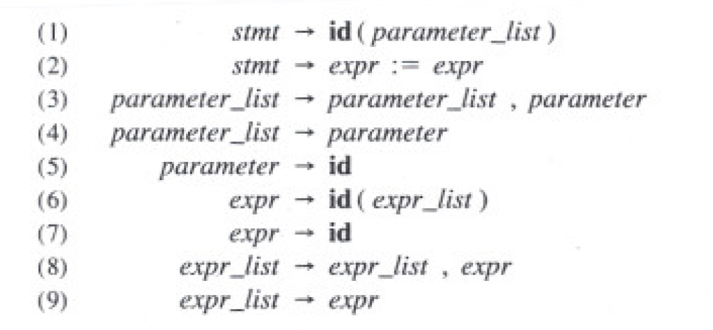
Example (reduce/reduce) conflict (procedure call or array)
Suppose we have a statement like A(I,J) using this Grammar:
?
?

Slide 118
Con’t: reduce/reduce conflict (procedure call or array)
After shifting the first three tokens onto the stack:
Stack Input
…id ( id ,id)…
Note: id on top of the stack must be reduced;
the parser does not know which rule to apply ( 5 or 7?)

Slide 119
Con’t: reduce/reduce conflict (procedure call or array)
One solution is to change the token id in p.1 to procid
Stack Input
…id ( id ,id)…
Stack Input
…procid ( id ,id)…
1
2

Slide 120
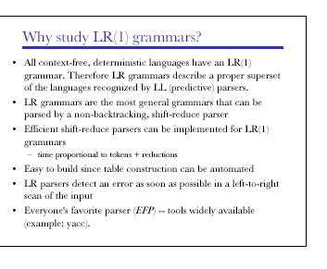
LR (1) Grammars

Slide 121
Final note on LR (k)
LR
More general and more expressive than CFG
The decisions are made at R.H.S of the rule using some or ALL part of the production
Uses more context than LL(k)

Slide 122
Problem with LR
Main drawback of LR
TOO much work to build an LR by hand
Need a tool, an LR parser generator (Yacc)
In case the hammer is ambiguous, then the tool can locates these issues by providing detailed diagnostic messages

Slide 123
How does SRP works
How does a SRP know what type of action should be performed?
Example of actions are
Shift
Accept
Reduce
Error
For example, how does the parser know the T on the top of the stack is not handle and therefore the right action is to perform shift?
The parser makes the right decision (S, R, Acc, Err) by building an DFA in which the states keep track of where we are during the parsing

Slide 124
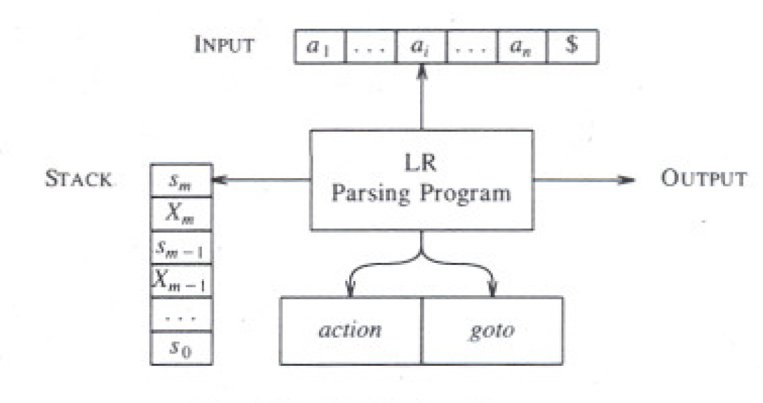
Model of LR Parsing
Goto(S_{i},N_{i})=S_{j}
Shift, reduce, accept, error

Slide 125
LR Parsing Algorithm
To create an LR parser, we need to construct a table (action + goto table)
Row = states
Columns = terminals and non-terminals.
Table entry can have four possible values
Shift
Reduce
Accept
Error

Slide 126
Shift action
shift state #:
Indicates that the current symbol should be pushed onto the stack, which means the automata should move to next state represented by state #.
The state # is pushed onto the stack.

Slide 127
Reduce Action
Indicates the number of state/symbol pairs that should be popped
The non-terminal that should be pushed back onto the input stream.
The table entry indicates (e.g., r_{j}) the production number to be applied to reduce L-H.S to R.H.S

Slide 128
Accept & Error actions
accept:
Accept the input string as valid if there are no symbols left on the input
error:
The current state doesn't have a valid transition for the current input symbol, which means the input string is invalid!

Slide 129
Quiz:

Slide 130
Model of LR Parsing

Slide 131
Building LR Parsing Table
How to build an LR parsing table for a given grammar?
If we can build a parsing table for any given grammar G, then G is said to be an LR grammar
To be an LR means
Left-to-right SRP that can identify handles on the top of the stack

Slide 132
Toward Building SLR Tables
The SLR Parsing table
Build the collection of Items from Grammar
Group items into sets
Map sets into the states of the SLR parser

Slide 133
An item of LR(0)
Item of a grammar G?
A production of G having a dot “.” at some position
dot?
Before dot “.” represents part of a production that has been seen at a given point
After dot “.” represents part of a production remains to be seen

Slide 135
More on Items
Example: A→XYZ
items for A→XYZ results the following productions
A→.XYZ
(i.e., we are hoping to see substring deriving from XYZ next on the input)
A→X.YZ
(i.e., we have seen on the input a string derivable from X and hoping to see a string derivable from YZ)
A→XY.Z
A→ XYZ.
(i.e., it is time to reduce XYZ to A. i.e., the handle is found)

Slide 136
Canonical LR(0) Collection
Canonical LR(0) Collection
Refers to set of LR(0) items, which can be used as the foundation for building determinates finite automaton (DFA) where
Each set of items maps to the state of DFS
GOTO represent transitions

Slide 137
construction of the canonical LR(0) collection for a grammar
To construct the Canonical LR(0) Collection for a grammar G
Augment grammar G
Use two functions
Closure (I)
Generates more items to a set of items
GOTO (I, X)
Works as a transition in LR(0) automaton by moving the ‘.’ past the symbol
If G is a grammar having G as a start symbol, then G’ is the augmented grammar for G with a new start symbol S’
G’→G (G’ is used to signal the successful parsing (stop!))

Slide 138
Closure of Item Sets?
Suppose I is a set of items, then CLOSURE (I) can be obtained by these rules:
Add every item in I to CLOSURE (I)
IF A →α.Bβ is in Closure(I) and B→q is a production, then add the item B→.q to Item I.
Repeat rule 2 until no more new item can be added to closure(I) (See figure 4.31)

Slide 139
Example 4.40
If I is the set of one item {[E’→.E},
Then CLOSUE (I) contains the set of item I₀

Slide 140
How to compute Closure I₀
How to compute closure E’→.E ?
E’→.E
<by rule 1 add it because an E is right after the dot at R.H.S>
E→.E + T
E→.T
<by rule 2 add E productions with dots at the left end.>
Apply rule 2 for all productions related to T, and F, we get I₀

Slide 141
Complete set of Items
If I is the set of one item {[E’→.E]}, then closure (I) can be
E’→.E < by rule 1>
E→.E + T < by rule 2: if A →α.Bβ, then add B→.q >
E→ .T < by rule 2 >
T→.T * F < by rule 2>
T→.F < by rule 2>
F→ .(E) <by rule 2>
F→ .id <by rule 2>

Slide 142
Complete collection of All possible items using closure

Slide 146
GOTO Function (transitions)

Slide 148
Use of the LR(0) Automaton
The main idea behind Simple LR parsing is to build LR(0) automaton from the Grammar where
States = Sets of Items
Transitions = GOTO functions
How LR(0) automata help with shift-reduce decision?
Being in state, say, j, perform shift on input ‘a’ if there is a transition on ‘a’
Else perform reduce using items in J

Slide 149
Example 4.43
Fig:4.34:The Parse of id*id

Slide 150
Architecture of LR Parsing

Slide 151
Algorithims:4.44: LR Parsing algorism
INPUT: An input string w and LR_Parsing Table
Output: If w is in L(G), the reduction steps of bottom-up parse for w; otherwise, an error indication
Methods: Initially, the passer has s₀ on its stack, where s₀ is the initial state and w$ in the input buffer.

Slide 153
Shift state 5 stack , and move input pointer

Slide 154
Reduce using Rule 6

Slide 155
Reduce using Rule 6

Slide 157
Constructing SLR-parsing Tables
Assume Grammar G’
Build C = {I₀,I₁,…,I_{n}} for G’
Construct State i using I_{i}
The parsing actions for state i are determined as follows
If [A→α.aβ] is in I_{i}, and GOTO(I_{i}, a) =I_{j}, then action [I,a] = s_{J} (shift state j)
If [A→α.] is in I_{i}, then action[I_{i} ,a] = reduce A→a for ALL a in Follow(A) (assuming A is not S’)
If [S’→S.] is in I_{i}, then action[I_{i}, $] = accept
The goto transition for state I_{i} is build using non-terminal A: if goto(I_{i}, A)=I_{j}, then goto[I_{i},A]=J
All entries not defined by rule 2, 3 are made “error”
The initial state of the parser is the one constructed from the set of items containing [S’→S.]

Slide 158
Example 4.47: 1 (building table)
Let us build the SLR table for the augmented expression grammar ( see fig .4.13). Consider the set of item I₀ as follows:
E’→.E
E→.E + T
E→ .T
T→.T * F
T→.F
F→ .(E)
F→ .id

Slide 159
Example 4.47: 2
Consider I_{0 (state 0)}
The item F→ .(E)
Results transition (i.e., action [0, (] =s4)
The item F→ .id
results action [0, id] =s5
No actions for other item

Slide 160
Complete collection of All possible items using closure

Slide 161
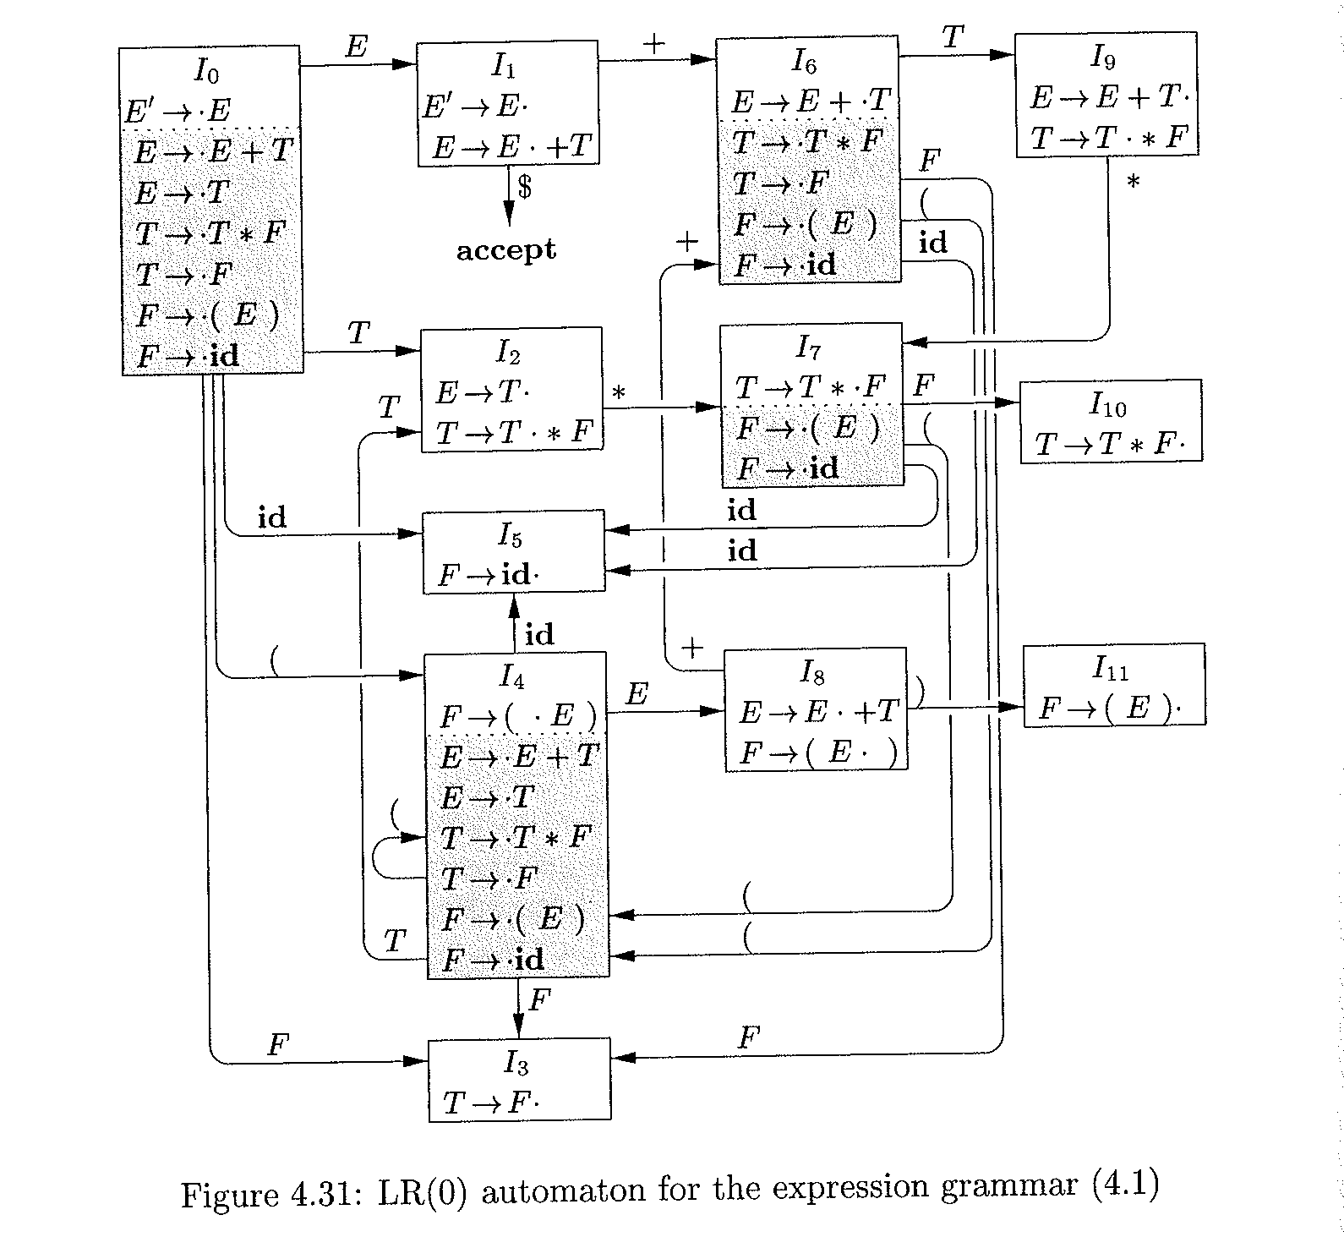

Slide 162
Fig4-31
Si :shift and stack state i;
Rj: reduce by production numbered by j
Acc: accept;
Blank: error

Slide 163
Fig4-31
Si :shift and stack state i;
Rj: reduce by production numbered by j
Acc: accept;
Blank: error

Slide 164
Example 4.38 (Reduce)
Consider I₂
E→T.
T→T.*F
Since FOLLOW (E) = { $, +, ) } and E = E’ then
action[2, +,]=action[2, )]= action[2, $]=Reduce E→ T (r2)
Using this rule:
If [A→α.] is I_{i}, then action[I_{i} ,a] = reduce A→a for ALL symbols of a in the Follow(A)

Slide 165
Fig4-31
Follow (E)= { +, ), $}

Slide 167
Second Item
I₂ makes
Action[2, *] = s₇

Slide 169
Fig4-31

Slide 170
Fig4-31
Si :shift and stack state i;
Rj: reduce by production numbered by j
Acc: accept;
Blank: error

Slide 172
Fig4-31
Si :shift and stack state i;
Rj: reduce by production numbered by j
Acc: accept;
Blank: error

Slide 173
Advanced Topics
Optimizing a grammar
Reducing the size of LR(1) tables
Combining rows/columns
Shrinking the Grammar
Directly Encoding the table
Using better construction algorithms

Slide 174
Optimizing a Grammar
There is a correlation between number of productions rules and amount of work to parse
Top down Parser
Works with derivation
Bottom up Parser
performs a reduction for every single derivation

Slide 175
Derivation
Rewrite the grammar to shorten the height of parse tree because the shorter tree translated into
Shorter derivation
Shorter time to parse
Less reductions
Optimization has no effect on the behavior of parser

Slide 176
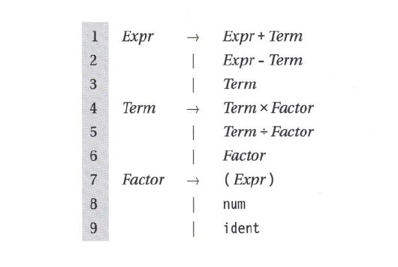
Example: Expression Tree

Slide 177
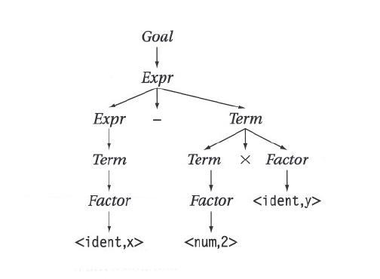
Parse Tree for Exp. Grammar
A node with a single child is a candidate for optimization
(x – 2 * y)

Slide 178
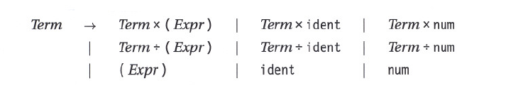
Revised Grammar
Obtain revised grammar by substitute for Factor by its alternatives
increases the # of alternatives for terms
Shrinks the parse tree by eliminating a layer

Slide 179
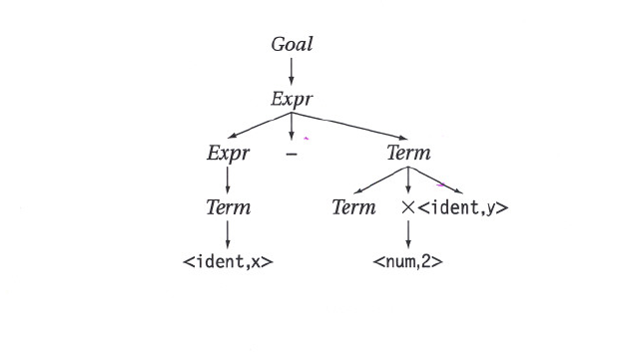
Revised Expression Grammar
(x – 2 * y)

Slide 180
General rule
Useless productions
Production having a single symbol on R.H.S
Use for performing a specific action
Fold away useless productions
Can increase the size of table in LR(1)
remove one columns while it may add many rows
Can increase the number of comparison in LL(1)

Slide 181
Reducing the size of LR(1) tables: Combing Rows/Columns
LR(1) generated for even small grammars can be large
Combining rows/columns results in a direct reductions in table size and an extra indirection to access the table
Need to understand the tradeoff

Slide 182
Combing Rows (or columns)
Find two identical rows (or columns)
Each set can be implemented by table generators once
Remap parser-state to row-index in action table
Same things for identical columns

Slide 183
Shrinking the grammar
To shrink the grammar
Reduce the number of production rules
Example
Factor→ num| ident ( * /)
Can be rewritten
Factor→ val
Action tables?
Removes a column from action table
Scanner must return val for ident or num
See the table

Slide 184
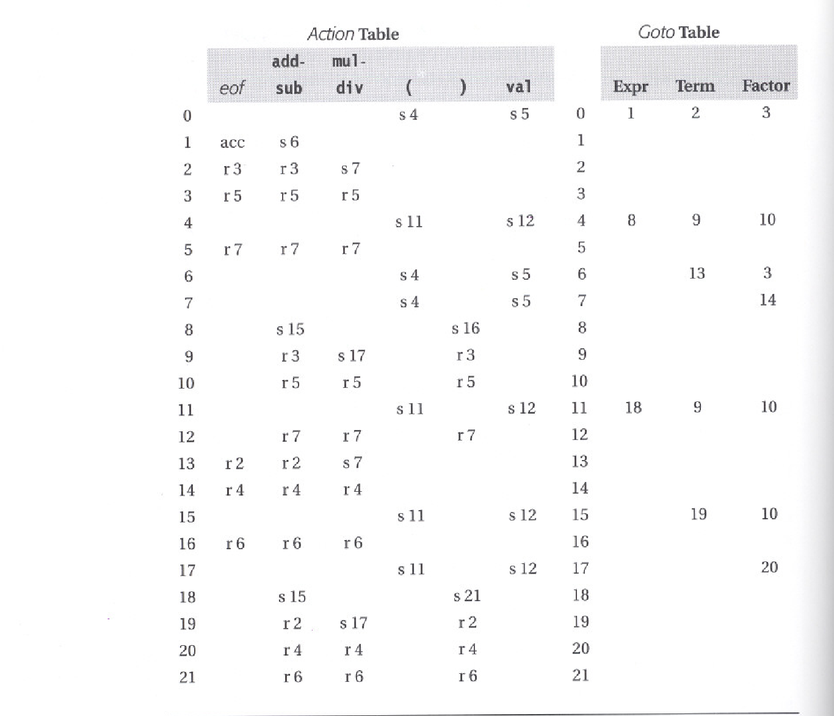

Slide 185
Directly Encoding the table
Forget about the table driven approach
Use hard-coded implementation
State is coded as case statement (IF-THEN-ELSE)
Test the type of next symbol
Perform
Shift
Reduce
Accept
Error
no table operations, no overhead (good)
No table lookup
Larger code size (bad)
Not readable (bad)

Slide 186
Using Other Construction Algorithms
LR(1)
The most general table construction algorithms
Produces the largest tables, but accepts the largest class of grammar
Is there other variation of LR(1) algorithms?
Simple LR(1) (or SLR)
Accepts smaller class of grammars than LR(1)
Uses FOLLOW set instead of Lookahead symbol to shift or reduce
FOLLOW set results in smaller tables
LookAhead LR(1) (or LALR(1) )
Works on the assumption that some items in the set (state) are critical that rest can be derived from them

Slide 187
Top-Down vs. Bottom up
Adv. of Top-down
Easy to build hand-coded parser
Provide excellent opportunity to detect/recover errors
Easy to find ambiguities
Faster (well-constructed ones!)
Adv. of Bottom-up
Tool support
Handles a lager class of grammars

